Slide 1
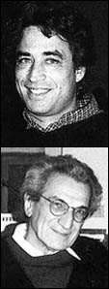
Lecture Nine: Hardt and Negri

Slide 2
Empire
Empire is a new economic, political and legal global order which is supranational, and regulates economic flows and exchanges.
It is defined by a new form of sovereignty which is no longer based on the nation state – rather it is decentred, diffuse and based on hybrid networks of communication, production and control.
Empire has no territorial borders – it is everywhere and encompasses the entire globe.
It must be distinguished from imperialism in the sense that no particular country or region controls it.

Slide 3
Key players in Empire
Amongst the new key actors in Empire and transnational corporations and the financial institutions.
Many corporations are no longer based in any one particular country – their identity is fully transnational.
Transnational corporations account for 70% of world trade and 20-30% of world GDP.
Transnational financial institutions like IMF, WTO and the World Bank provide the regulative and legal framework in which corporations operate. Free Trade Agreements are like Bills of Rights for corporations.
However, neither these institutions nor corporations control Empire – they are simply part of it. Nobody controls Empire.

Slide 4
Empire is a juridical order
It is based on the idea of a world order providing an international legal framework
Enshrines the idea of a juridical right and legal authority which is supranational and stands above nation states (like Roman law)
Concept of just war is central: implies a new notion of the right of Empire to intervene militarily against those who rebel against it and threaten to destabilise it.
Military interventions are constructed as ‘ethical’ police actions

Slide 5
Empire as a normative order
Empire produces new norms, values and discourses which at the same time act to legitimise it.
Construction of a new ethical paradigm, and a new structure of self-reference.
Central value is maintenance of peace, order and stability.
Right of intervention, not only militarily but also on humanitarian grounds.
  Humanitarian NGOs are like the moral agents of Empire.

Slide 6
Biopolitical Production
The dominant mode of production in Empire is no longer industrial but post-industrial or biopolitical – ie., aimed at the production of networks of knowledge, communication, social relationships and forms of life.
Communication is a way of organising the movement of globalisation – globalisation is based on the ‘knowledge economy’.
Immaterial labour:
  Communicative labour of industrial production that is linked to information
  Interactive labour of symbolic analysis and problem solving
  Labour of the production and manipulation of affects.
Software programmers, call-centre workers, scientific researchers etc have become the new proletariat. Their labour is exploited and alienated in the same way, through the extraction of surplus value.
The knowledge and technology produced here has the potential to allow new forms of commonality (eg file sharing, OpenSource software etc) – but at the same time, this is in tension with the capitalist conditions of private property under which it is produced.
Immaterial labour produces a new collective biopolitical body – a new form of life which is in contradiction with Empire.

Slide 7

Immaterial Labour: Call centre operators

Slide 8
Resistance to Empire
Empire is a progressive historical force because it has the long term effect of uniting and internationalising the proletariat – breaking down national differences (we are all being exploited in the same way everywhere)
The Left should not be opposed to globalisation – it should want more globalisation.
Produces a new collective biopolitical body – the multitude – which will one day turn against Empire. Empire is sowing the seeds of its own downfall.
The new proletariat manifests itself in a series of seemingly unrelated events – LA riots 1992; Tiananmen 1989; Palestinian intafadas; Zapatista rebellion in Mexico.

Slide 9
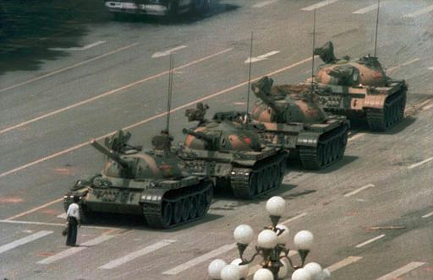
Incommunicable events: Tiananmen Square protests 1989

Slide 10
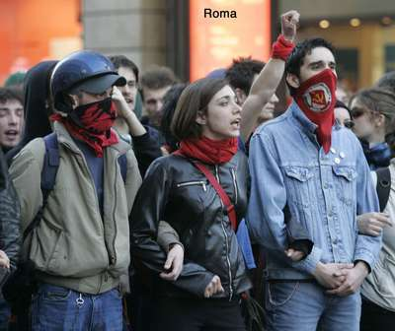
Anti-globalisation struggles

Slide 11
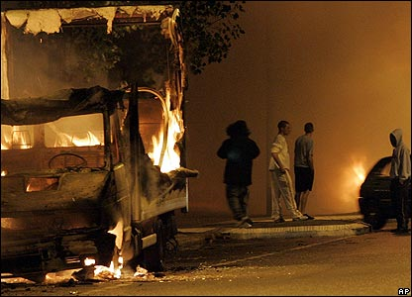
Incommunicable events: Paris riots 2005

Slide 12
What is the Multitude?
The multitude refers to all those who work under Empire, but primarily those involved in immaterial labour.
  Class concept – but different to Marxist notion of blue collar worker.
It is neither a unity nor a plurality, but rather a singularity – combining the one and the many.
It is an open potentiality rather than an actual identity – more of a becoming.
Suggests the possibility of a common social being and a common political project.
While sovereignty is dependent on the multitude, the multitude does not need sovereignty. It will one day turn against the sovereignty of Empire.

Slide 13
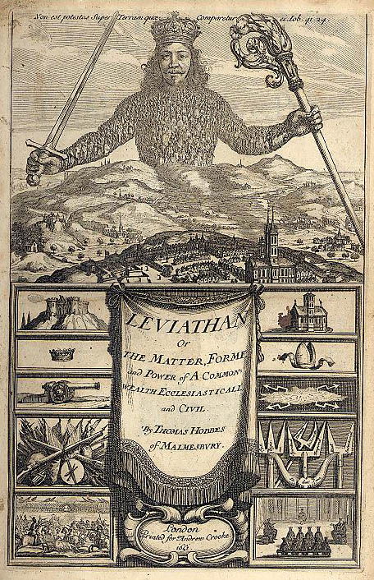
The Political Body: the Sovereign and the Multitude

Slide 14
Democracy of the Multitude
The multitude can embody its own form of democracy without sovereignty – a form of collective decision-making without any defined centre of power.
Concept of ‘swarm intelligence’ – collective decision is taken spontaneously and without coercion.
Combines Lenin and Madison
  Lenin – idea that Communist revolution that abolishes the State.
  Madison – checks and balances, the fragmentation and pluralisation of power
Measures to democratise globalisation
  People’s Assembly – based on non-national population districts
  Extension of jurisdiction of international legal and human rights institutions
  Implementation of the Tobin Tax
  Elimination of international controls on intellectual property

Slide 15
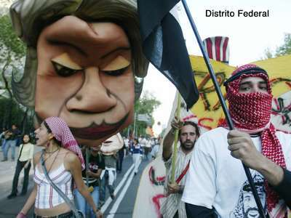
New weapons

Slide 16
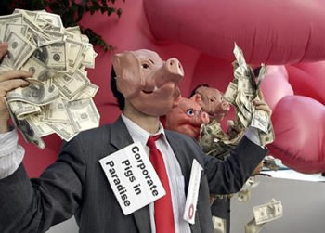

Slide 17
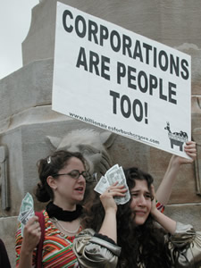

Slide 18
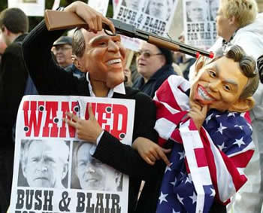

Slide 19
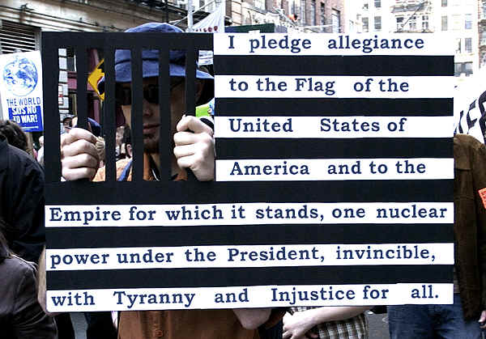

Slide 20
